Slide 1
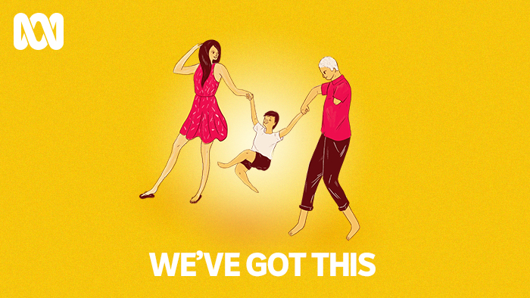
Parenting with a Disability
A series produced by Eliza Hull

Slide 2
About me
My name is Eliza Hull and I am a mother with a physical disability. I have a neurological condition ‘Charcot Marie Tooth’
When I was pregnant with my daughter I felt unrepresented in all of the parenting books
Discouraged, I set out to change this by creating a project that represented parents with disabilities
I was the Regional Storyteller Recipient of 2018 with the ABC. This is a scholarship for a person with a disability, who lives regionally in Australia
This scholarship enabled me to produce my project idea which eventuated in the series ‘We’ve Got This’ on parenting with a disability

Slide 3
Objectives
My aim was to share the stories of parents with disabilities in a way that accurately represented their lives
I didn’t want to sensationalise their stories
I wanted to change perceptions about what it meant to be a disabled parent
I wanted disabled people to feel less alone in their decision to parent
My aim was to change some of the barriers that parents with disabilities face

Slide 4
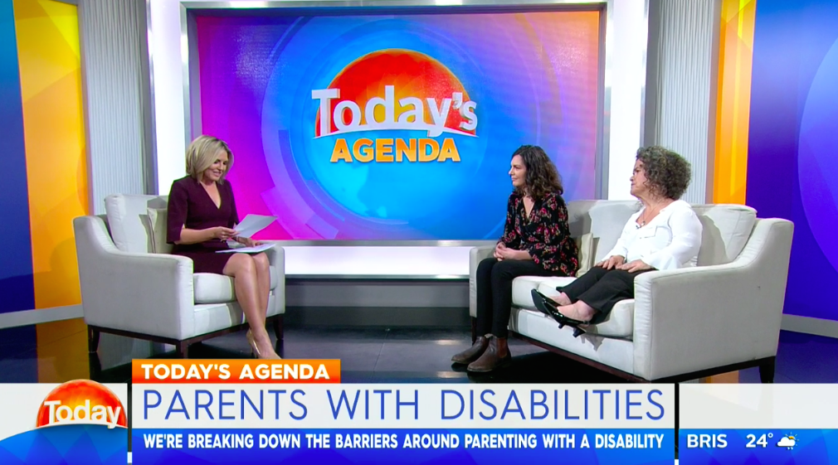
What was produced?
Eight part audio series with Radio National ‘Life Matters’
Feature articles and video for ABC Life
Promotional interviews with the BBC, The Today Show, 730 Report, ABC News Breakfast
Articles on Scary Mommy, Mamamia and Zen Mama

Slide 5
Barriers that disabled parents face
The misconceptions that disabled people cannot be competent parents
Discrimination
That our children will be looking after us
That it is rarely in the best interests of a child to be raised by parents with an intellectual disability, which leads to the removal of children
The belief that disabled people can’t parent and therefore shouldn’t
The belief that because we have complex needs of our own how can we provide care for another
That it will be too challenging for the parent
That the child will miss out
Lack of support, accessibility and education

Slide 6

EMMA BENNISON

Slide 7
AMANDA WHITE

Slide 8
JAX JACKI BROWN

Slide 9
Impact series is making
I believe that the series is breaking down barriers
Women with Disabilities Victoria are now using the series to inform their sexual reproductive health in workplace development
Organisations are using it to educate their staff
Disabled parents are now sending the series to their mother groups, so it can do the explaining for them!
The most important step - is changing people’s perceptions
The series is representing people with disabilities and hopefully making them feel less alone in their decision to parent

