Slide 1
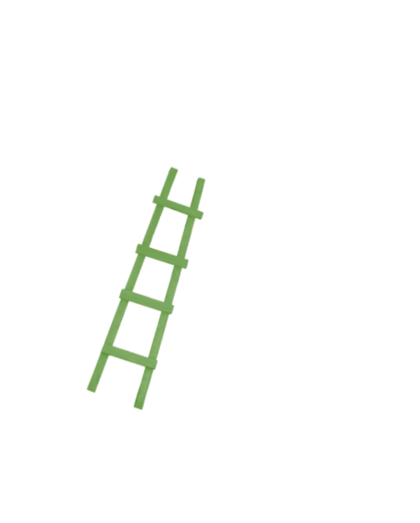

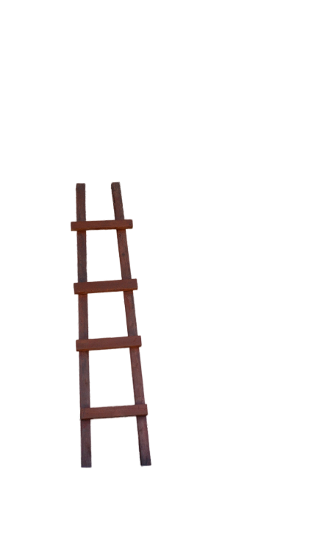
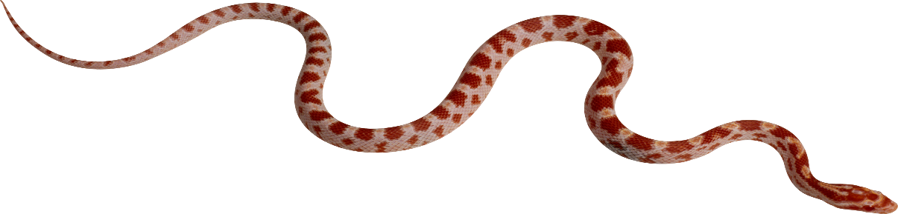



The NDIS and Mental Health:
36 | 35 | 34 | 33 | 32 | 31
25 | 26 | 27 | 28 | 29 | 30
24 | 23 | 22 | 21 | 20 | 19
13 | 14 | 15 | 16 | 17 | 18
12 | 11 | 10 | 9 | 8 | 7
1 | 2 | 3 | 4 | 5 | 6
A game of snakes and ladders

Slide 2
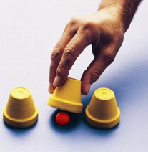
It could be you…
Notes:
Mental health conditions come in many forms and are experienced in differing ways. This will not be news to you. Just think for a moment though … many mental health conditions arise from trauma. A situation or environment a person experiences that is so intolerable that the brain does what it has to in order for the person to survive. This is a very simplistic version of trauma and the very normal responses to trauma, but sometimes simple is better. Trauma is indiscriminate. None of you can know with definite certainty that you will not experience such a traumatic event or circumstance in your life that your brain will do what it has to do in order to survive.

Slide 3

Australia – the lucky country
Notes:
Just imagine, you’re going about your life getting on with business. You might be helping people with mental health conditions; providing a service or writing policies for the benefit of these people. You feel good because you are contributing to a worthwhile cause, you are doing good for humanity. You have an income, a family, a home, friends and you can socialise. You may even have hobbies or things you enjoy doing that you can pursue. There will be times when things can be monotonous, responsibilities can be heavy, families can bicker, you’re short of cash – these are problems of the western world. By pure luck of geography you were born (or chose to come) to live in Australia. If you were in Iraq say for instance, you would literally be trying to stay alive amongst warring factions. Yet here you are, in Australia, the lucky country. Forging your way ahead, choosing how you live your life.

Slide 4

Life as you know it has irrevocably changed
Notes:
Out of the blue (or even sneaking up on you), the big ‘T’ happens. It’s nothing like you’ve ever experienced before and your brain does all it can to keep you alive. This will happen, either to you or someone you care about. Life as you know it has irrevocably changed. You can’t control the way you think or the thoughts that invade your mind. You can’t concentrate or remember even little things. You are constantly sad and anxious and you beat yourself up over it because you can’t seem to do anything, you can’t function. You can’t go to work and you lose your income. You can no longer afford to pay for the life you had been living let alone the bills or mortgage / rent you need to pay in order to keep a roof over your head. Friends start to drop off and you don’t care or even notice because you just need to be alone with no additional stress or obligation, just to exist. It’s hard to even form words. Everything is hard and you are constantly exhausted.

Slide 5

You are broken and no longer useful to society
Notes:
After some time (months maybe even years) you learn to adapt to this new way of living. You become the master of avoidance and denial, you crave your solitude and you do whatever you have to in order to feel safe. Isolation is your new best friend. People have started treating you differently like they are scared of you or that what you think is no longer valid. They dismiss you and all of your life experiences and knowledge. To them you are broken and no longer useful in contributing to society.

Slide 6
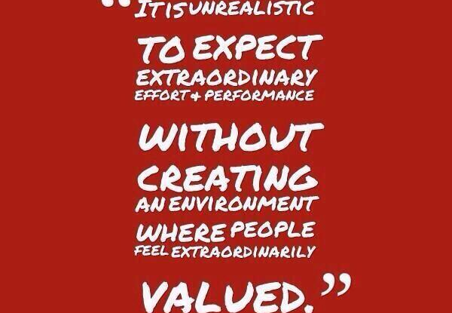

Notes:
In a work setting, I’m a firm believer that every person starts the day with every intention of giving it their best. This doesn’t always eventuate but the intent would have been there initially. And why is there this intent that a person has? It is because they want to believe that what they have to contribute matters, and really when you hone down on this, it is because they intrinsically want to be valued. This is no different for a person with a mental health condition on their personal recovery journey. If this was you, this would be your deepest longing as well. Remember this when you’re working with people, writing policies or designing new support programs for people with a mental health condition. Think about how you would like to be treated if it was you reaching out for support because it takes a lot of guts to ask for help.

Slide 7
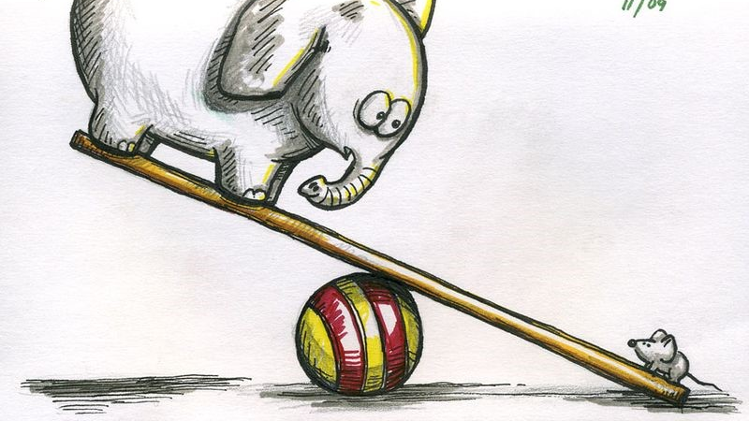
It takes courage to ask for help
Notes:
Think of the times that you have needed to ask for help with something really significant, something that you have needed desperately. From the onset of your request, there is a power imbalance – you need something and the other person has it. It is entirely up to the other person as to whether they give this thing to you and if they do, you feel obligated to them. There is also an element of failure and worthlessness you may experience at not being able to meet your own needs. Imagine the depths a person has reached when they have to ask for help for their own mental health and the courage it has taken to ask for this help.

Slide 8

Notes:
Why have I raised this? To remind each and every one of you that we are talking about people, real live human beings – not clients, consumers, patients or participants – people. People like you and me. Labels impersonalize and box people when we are all so much more. Labels can trap people and confine them, stunting growth. I understand the need for labels; to describe something, to categorize something, to assist in workplace systems but it is a sad day for humanity when we forget that labels assist workplace systems and start seeing the people as their labels.

Slide 9

“assistance for people with a disability to develop skills to optimize their ability to live an ordinary life and to exercise choice about the support they receive.” (Accessing the NDIS; Assisting people with psychosocial disability to access the NDIS: a guide for Commonwealth-funded community mental health service providers p2
Notes:
Keeping in mind that we all want to be valued for who we are and the guts it takes to ask for help, add to this the mix of symptoms caused by a mental health condition and the stigma attached. Enter stage left, the NDIS. It has been designed to provide “assistance for people with a disability to develop skills to optimize their ability to live an ordinary life and to exercise choice about the support they receive.” (Accessing the NDIS; Assisting people with psychosocial disability to access the NDIS: a guide for Commonwealth-funded community mental health service providers p2). Fantastic! Sounds perfect because as human beings navigating a self-recovery journey, we know what would benefit us the most, what would help to give us the best shot at living an ‘ordinary life’. Because after all, each one of us is different and that is where the NDIS really steps up because it recognizes this difference and wants to support our own individual goals. Finally, we will be listened to and validated.

Slide 10

Set adrift from supports
Notes:
In order to pave the way for this new way of doing things, most of the old services and supports were removed…
This in itself has been quite challenging for people with mental health conditions because while these services were not perfect – they were something. Support was there if needed. Like a pair of comfortable, worn-in pair of slippers, people knew what to expect which relieved some anxiety. Predictable and reliability are friends for people navigating their own personal recovery journey. Finding out that these services were no longer available was like ‘pulling the rug out’ for many – leaving them off balance, out of kilter, disoriented, confused – and for some, crashing to the floor and needing hospitalisation.

Slide 11


NDIS
Notes:
A lifeline was thrown out though – services would continue through the NDIS and the NDIA backed this up saying, ‘no-one would be worse off’.

Slide 12

Losing its shine
Notes:
Like all things shiny and new, the NDIA showed some promise. People were being transitioned over to the scheme from defined programs and there was some excitement with personal goals being supported. Really, our ‘spidey-senses’ should have started tingling with the NDIA calling people ‘participants’. The Oxford Dictionary definition of a participant is a person who takes part in something. So, while some are taking part, some are not … and in the case of the NDIA, many are not.

Slide 13
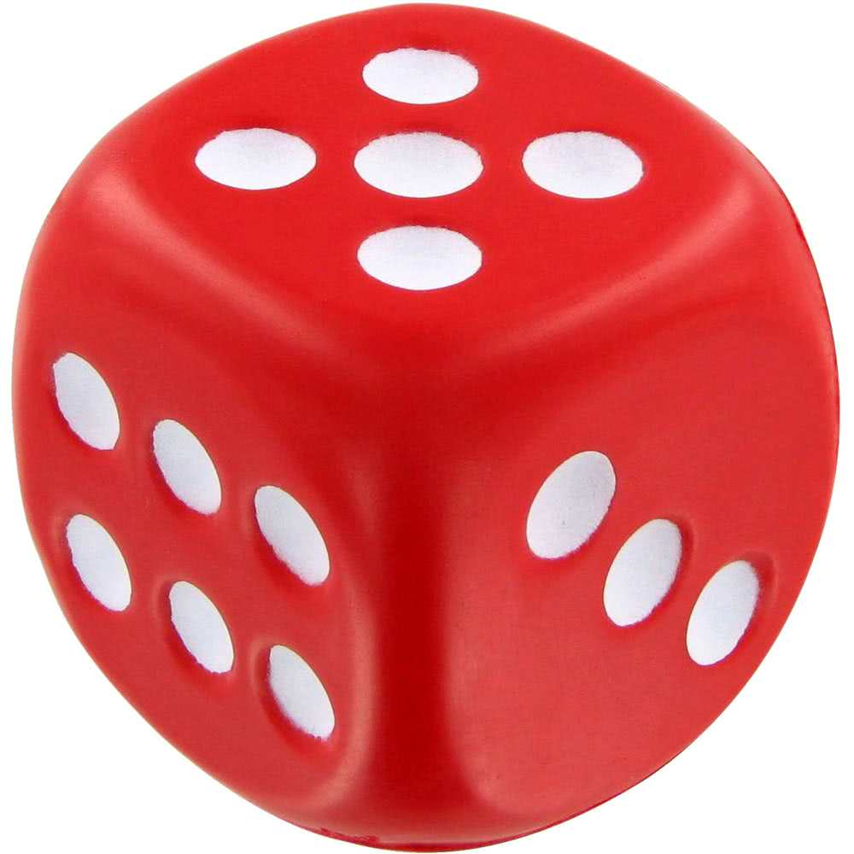



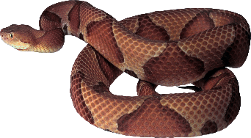
36 | 35 | 34 | 33 | 32 | 31
25 | 26 | 27 | 28 | 29 | 30
24 | 23 | 22 | 21 | 20 | 19
13 | 14 | 15 | 16 | 17 | 18
12 | 11 | 10 | 9 | 8 | 7
1 | 2 | 3 | 4 | 5 | 6
Choice and Chance
Notes:
The best way to demonstrate the NDIS for people with psychosocial disability is to use an analogy of the game ‘Snakes and Ladders’. Why a game you may ask? Because the NDIS has participants, rules and you need a lot of luck.
Take the cohort of people with psychosocial disability, set adrift from all they have known, and give them a choice - play the game or get no supports (at least in Victoria). What a great start to the NDIS mantra of choice and control.

Slide 14
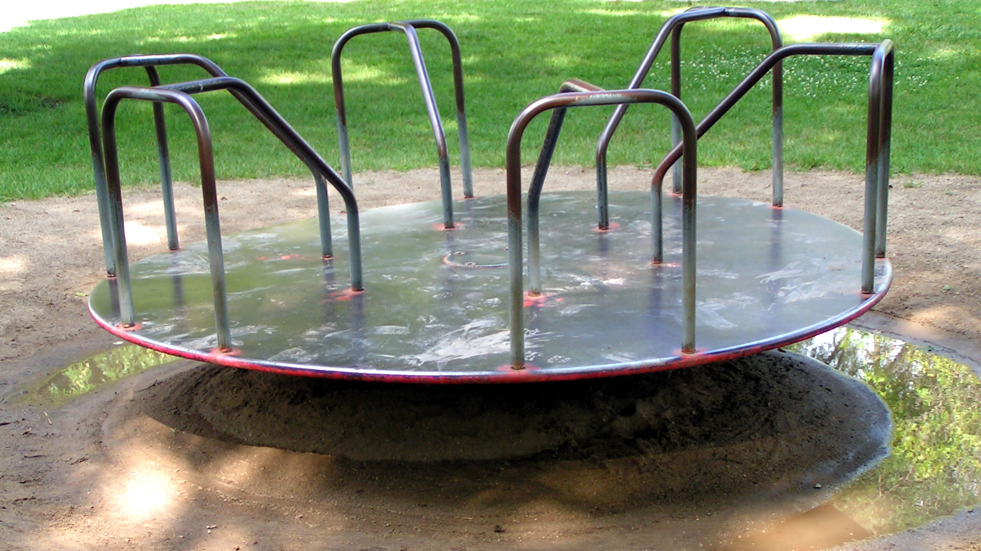
torture
Notes:
Just for the fun of it, let’s put in some spinning playground equipment BEFORE the starting line and see who is left standing (albeit in a confused, anxious, distressed, traumatised and unwell manner). To roll the dice, a person will have had to:
Add the label disability on top of their mental health
Gather various evidence needed (identify, cost and timeliness)
Ensure the evidence needed is written in NDIS language (focussed on what a person can’t do)
Rely on health professionals to agree to write up reports despite a lack of information on how to do this
Revisit and refocus on all the parts of their life that cause them anguish, pain, feelings of failure, unworthiness, guilt, feelings of helplessness
All this, while living with a psychosocial disability that in itself can affect memory, thought processes, organisational ability, motivation …
All this, while a person is struggling to stay out of bed, can take weeks to build up the courage to make a phone call, is literally battling to stay alive…
All this, to get some continuity of service to support their recovery pathway that they had previously had.
Revisiting trauma is traumatising within itself. No wonder people drop off the pathway leading to the NDIS, they either end back in hospital or hide and isolate from society to protect themselves, wanting nothing to do with the NDIS and the supports they really need. Others have to get well enough just to attempt it again … and they haven’t even begun to play the game.

Slide 15

Cruel
and inhumane
Notes:
It’s hard to believe we are so cruel and inhumane.

Slide 16

Access Denied
Notes:
I’m not going to elaborate on each roll of the dice on this NDIS Snakes and Ladders Game. If you have had anything to do with the NDIS you will know the ‘snakes’ such as ‘one-dollar plans’, removal of support coordination, insufficient funds, lack of psychosocial disability knowledge with both the NDIA and Local Area Coordinators (LAC), lack of early intervention and the appeals and reviews process. There is a vicious snake I want to mention though:
Access Denied – with the ‘biggies’ being around:
Treatment
In particular, not all treatment being exhausted including compliance with medication. If the NDIA and their lawyers don’t know that:
Not taking medication can be a psychosocial disability within itself
There is no overwhelming evidence to suggest that certain treatments can remedy psychosocial disability
That a person has a right to choose what treatment they want
then the NDIA have no right in assessing psychosocial disability applications for the NDIS. Not only are people being discriminated against, punished for having a psychosocial disability – they are also at risk of losing perhaps the only support they have left, in medical practitioners. Some medical practitioners are refusing to complete further evidence as they feel their expertise in previous reports has been disregarded. The only loser here is the person who was meant to be helped.
Substantial functional impairment
Regardless of the NDIS Act 2013 separating psychosocial disability from other disabilities entities with the word ‘OR’ (NDIS Act 2013, 24 Disability Requirements 1(a) “the person has a disability that is attributable to one or more intellectual, cognitive, neurological, sensory or physical impairments OR to one or more impairments attributable to a psychiatric condition..” , 5.1 (c) the impairment or impairments result in substantially reduced functional capacity to undertake, OR psychosocial functioning in undertaking, one or more of the following activities…”, somewhere along the line psychosocial functioning has been lumped together with functional capacity for other disabilities to the point that the NDIA were saying that the functional impairment had to effect a person on a ‘day-to-day basis’ to now saying the functional impairment is on an everyday basis. Nowhere in the NDIS Act 2013 are the words ‘day-to-day’ and ‘every day’ used for access to the NDIS. Once again, this demonstrates a lack of understanding of the of psychosocial disability and its episodic nature and the failure of the NDIA to utilise appropriate assessment tools.

Slide 17

Wonderful experiences
Notes:
There are some ‘ladders’ in this game though, where people have had a fantastic experience. The NDIA and LAC’s have been wonderful and supportive, demonstrating a total understanding of psychosocial disability. There have also been attempts by the NDIA to build in more ladders with trialling new pathways. It is not all ‘doom and gloom’ but it still feels like a game as it appears to be reliant on luck. Luck in getting the right NDIA assessor, planner and LAC.

Slide 18

Where to next?
Notes:
A system which enables people with psychosocial disability to live an ‘ordinary life’, supports their goals and aspirations, gives them choice and control and assists in their own personal recovery journey, is needed. Any system which discriminates, devalues and injures a person further should be stopped.
The NDIS as it relates to people with psychosocial disability needs a major overhaul including simple and more appropriate assessment tools, including early intervention to prevent a worsening of circumstances and disability, including identified supports like a gym membership. These are things that could really assist a person on their recovery journey. When a person who is able to work has the luxury to utilise services like the gym, this is normal. It is not normal for someone who has lost their income, has very limited resources, struggles with their weight and ultimately self-esteem as a direct consequence to their mental health condition, experiences anxiety and distress in being able to do things that any other person wouldn’t even think twice about (therefore even contemplating going to the gym is a major positive step) to be able to pay for a gym membership. When something flouted as being so beneficial for psychosocial disability is out of reach, this is not normal.
Any services designed to support a person on their personal recovery journey needs to enhance - not damage, needs to value the person – not disregard, needs to see that mental illness and psychosocial disability are individual to each person – not a ‘one size fits all’ and how do these services identify what is really needed…

Slide 19

We are each the expert of our own lives
Notes:
By listening to what the person is saying they need, because they ARE the expert of their life. It may take a while for them to really verbalise what they need but the answers are in them. Remember, the person who is reaching out for help, who knows what would work for them, could be you.

Slide 20

Presented by
Jenny Bretnall
VMIAC NDIS Educator

