Slide 1
Victorian Housing Register
Overview
24 November 2016
Advocacy Sector Conversations Forum

Slide 2
Minister’s announcement
“The Victorian Housing Register will mean Victorians will only need to apply once, rather than put their name down with every agency.”
Simplifies the application process.
Consolidate all social housing waiting lists into a single place.
Provides a fair way for households to access a broad range of social housing options.
“It is a true partnership between government, community housing and homelessness sectors to make access to housing easier for Victorians.”

Slide 3
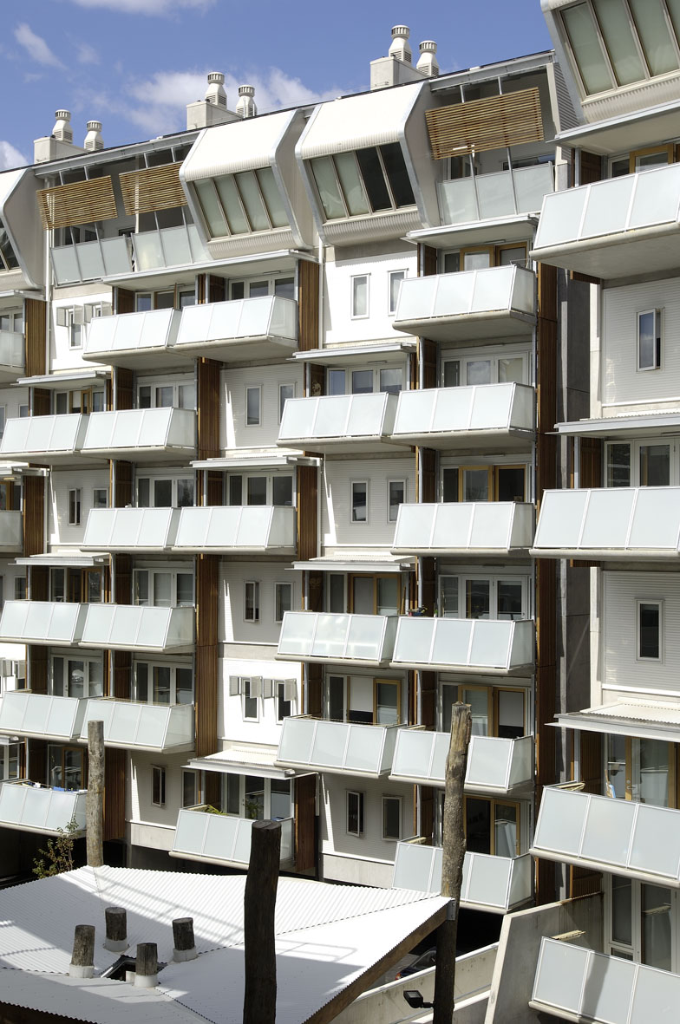
Types of social housing
Social housing is rental housing provided by not-for-profit, non-government or government organisations to assist people who are unable to access suitable accommodation in the private rental market.
Public Housing
Approximately 62,000 properties
Community Housing
Approximately 10,500 properties - includes
Aboriginal Housing Victoria
Housing Associations
Rental housing co-operatives
Rooming Houses
Specialist community housing organisations

Slide 4
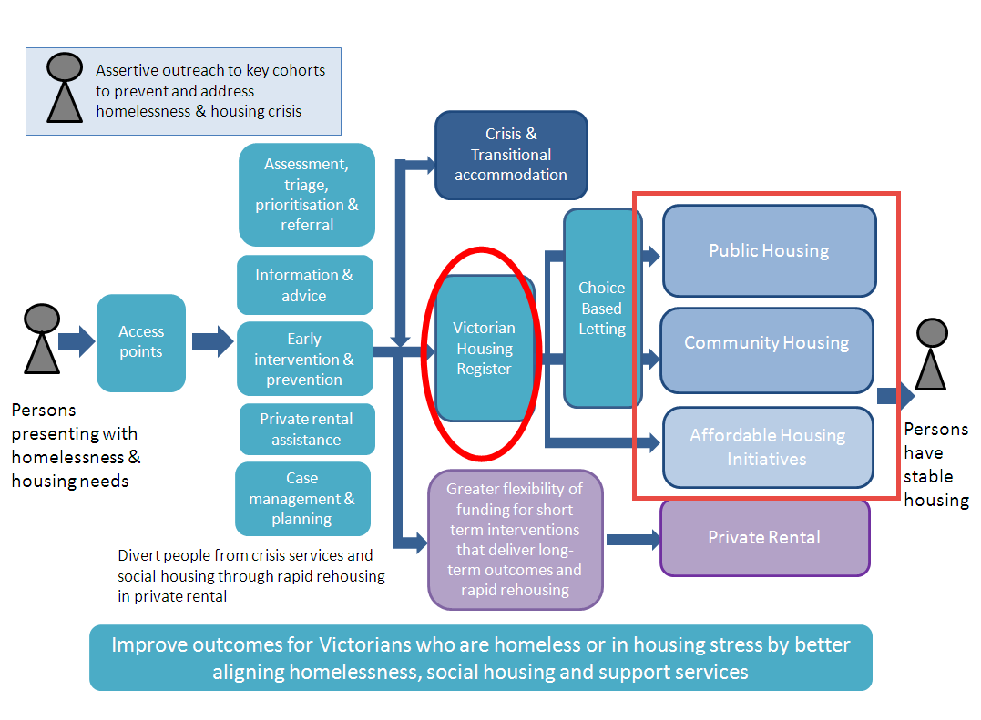
The Victorian Housing Register is a key component to delivering an integrated system

Slide 5
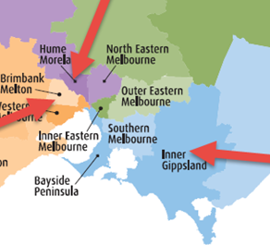
Social Housing reform – Launch sites
Brimbank Melton, Hume Moreland and Inner Gippsland are the three sites chosen to launch a new way of working across the homelessness and social housing service systems.
Objectives
Design and test new service approaches that aim to
reduce homelessness; increase choice, including
opportunities in private rental; and maximise links
between homelessness and social housing responses
Integrate homelessness services with social housing
and broader social services
Embed an environment and culture of continuous
improvement and innovation

Slide 6
Transition to the VHR
Public Housing waiting list migration into the register
Community Housing Providers commence migration into the register
Duplicate clients data cleanse
Register fully established
Housing Associations & Providers allocate directly from HiiP
The Victorian Housing Register: Timeline
August 2016
Early 2017
Mid 2017

Slide 7
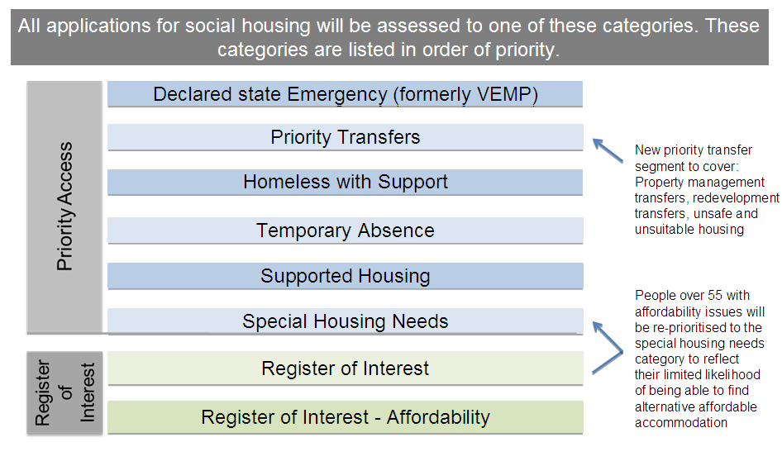
Structure of the Victorian Housing Register

Slide 8
Structure of the Victorian Housing Register: Access under Supported Housing Priority Category
Require significant personal support, then the options are:
Acquired brain injury
Aged care
Children, Youth and Families
Disability (non NDIS)
Mental Health
National Disability Insurance Scheme (NDIS)
Require full/major modifications
Major modification required to property (NDIS) – currently being implemented
Major modification required to property (Other)

Slide 9
Key Sector Roles
Support & Transitional Housing Providers
Support workers retain role of lodging “Homeless with Support” & “Supported Housing” priority segments Provide a short succinct summary of what is needed to ensure the tenancy can be sustained. IAP workers continue to assist with special housing needs applications.
Community Housing Associations
Assessing and lodging application on-line for property redevelopment & related transfers, as well as limited other applications, for example nomination rights Where appropriate, assisting people approaching their organisation by assessing and lodging application Option to assess application for DHHS processing

Slide 10
Key Department Roles
Housing Call Centre
Receive and data capture for new applications including transfers Access income confirmation information when needed Assess register of interest applications Assign applications to office where client lives for assessment Data capture applications for reassessment Operate help desk for online form
Area/housing Office
Assess priority applications Create applications in HiiP for redevelopment transfers Where appropriate, assist people with information and referral, or to lodge their own application on-line Process updates and reassessments Undertake two yearly reviews With Homeless and Support, pre-allocation checks when nearing the top of waiting list ( requires discussion)
Service Implementation Support Branch
Coordinate and support implementation and operation of the Register Operate a helpdesk for DHHS and CHO staff Support the governance processes, reporting and policy development, as required

Slide 11
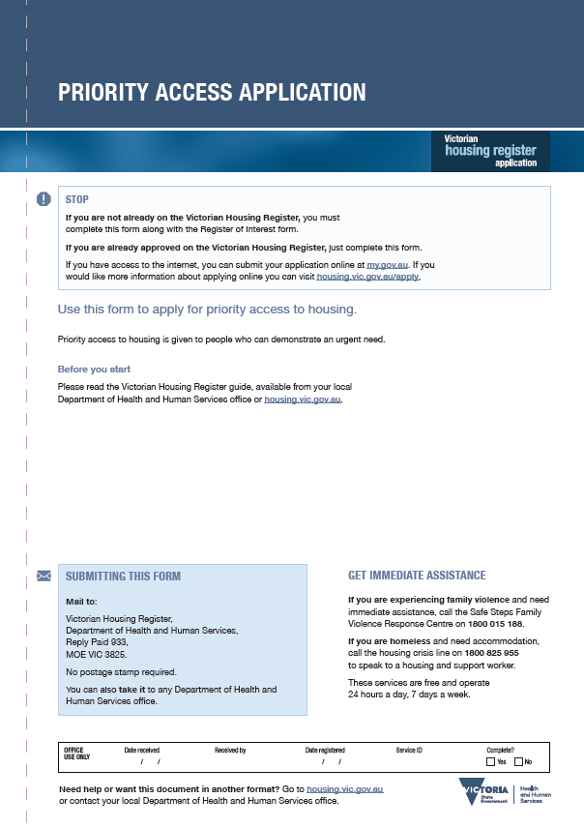
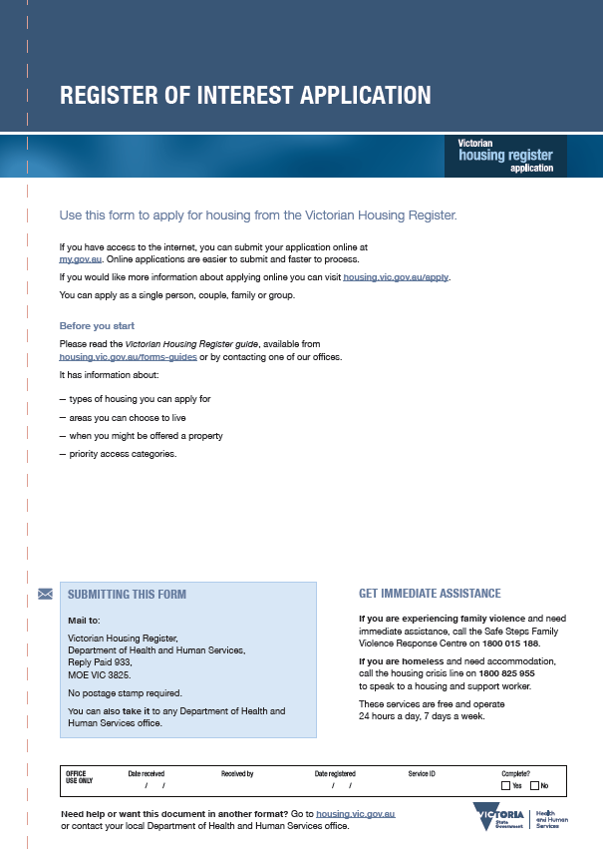
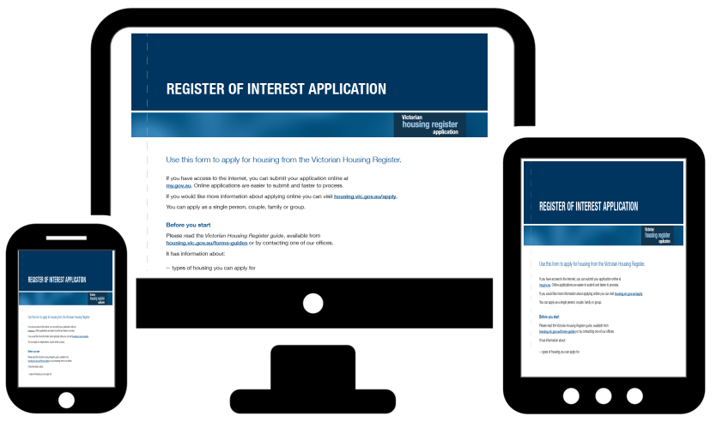
Application Forms
Two versions of the Housing Application form are available:
Online housing application Paper application

Slide 12
Paper application forms
The paper-based forms are available at www.housing.vic.gov.au:
Register of Interest application
Priority Access application
Note: Applying for a Priority Access category requires both forms

Slide 13



Online application pathway
Either the client or a support agency can submit the online form
Housing Call Centre
Proposed data input timelines:
Priority transfer is 24 hours
Priority is 3 days
ROI is 14 days
HELP line:
1800 149 361
Funded Agency Channel
eBusiness portal
Local DHHS office
Assessing priority applications
Process updates and reassessment
Agency Application
myGov
Login
Client Application

