Slide 1

DSP – the Brave New World

Slide 2

Acknowledgements
Country
[Auntie Di Kerr]

Slide 3

Before we start
Disclaimer(s)
Sarcasm/humour warning
Questions/queries
Presentation style
Clip Art

Slide 4
Social Security Rights Victoria Inc.
Previously The Welfare Rights Unit Inc
Founded in 1987 (Changed name 2009)
Specialist CLC
Independent social security advice
Not funded nor linked with Centrelink
Fed (70%) State 20% funding

Slide 5


Disability Support Pension 2012+
Hurdle 1:Diagnosed, Treated &Stabilised condition
Hurdle 2:20 points of impairment
Hurdle 3: Continuing inability to work - ’15 hour test’ (30 pre 10/5/05)
Hurdle 4: 2 year rule
[Hurdle 5: Program of Support]
Need either all 4 or 5 – ¾ doesn’t work..!
Traffic controller

Slide 6

Disability Support Pension – Hurdle 1
“Diagnosed Treated & Stabilised”
All the ‘Allopathic’ interventions !!
Determined by reports from
Treating specialists
Centrelink (contracted) Job Capacity Assessor and
‘Government Contracted Doctor’ – Post 1/7/15 – no ‘Treating Doctor’s Report’ (TDR) forms

Slide 7
DSP Hurdle - 2
Impairment rating = At least 20 points
If 20 points under one table = “severe” impairment
If at least 20 points across more than one table (e.g. 10 points each) also need to “clear” Hurdle 5 – “Program of Support”

Slide 8
DSP Hurdle -3
A ‘continuing inability to work’ – less than 15 hours per week
Now significantly related to hurdle 4 – “0-7 now, 8-15 with interventions, 15+ in 24 months”
Any work, not work qualified for
Knocks most folk out

Slide 9

DSP – Hurdle 4 – 2 year rule
Condition must be likely to last for more than 24 months – that is ‘permanent’ under Social Security legislation
Least ‘lost’ - except when aligned with hurdle 3

Slide 10

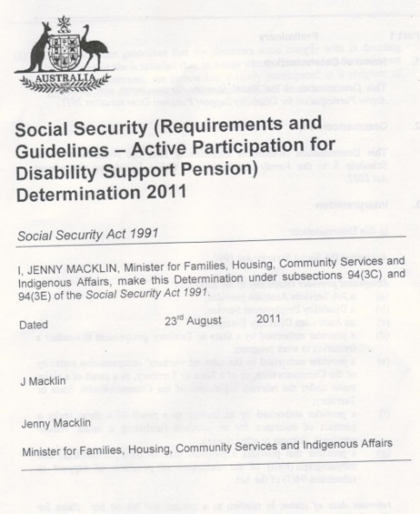

DSP– Hurdle 5
Hurdle 5: ‘Active participation in a program of support’ (POS)
A requirement if you don’t have 20 points under ‘one’ table (i.e. over two or more )
Effectively 18 months (out of the last 3 years) usually on NewStart and in a Disability Employment Service program

Slide 11
Other DSP 2012 Changes
‘Morbidity’ of Table 21
CFS
Morbidity

Slide 12

DSP 2012 Changes – Practical
Much harder tables - effectively if you qualified under the old tables, your chances or re-qualifing are very small
‘ Work –related affects rather than illness’

Slide 13
DSP 2012 Changes – Under 35s
Real target
Have to ‘prove’ you’ve spent
18 months attempting to
find work prior to going
on DSP
Not intended (we believe) to
affect those who go on @ 16

Slide 14

Issues for Pre 2012 under 35s & ‘entitlement losers’
Assessed under the post 2012 tables
Much more difficult to prove entitlement
Our guesstimate is 20% success @ best
Permanent Portability ‘scam’

Slide 15
Contacting SSRV
Phone 9481 0355 or 1800 094 164 (may change soon)
www.ssrv.org.au
info@ssrv.org.au
P O Box 1221 Fitzroy North 3068 (see above)

