Slide 1
Office for Disability Update
Fleur Campbell, Senior Project Officer
Email: Fleur.campbell@dhhs.vic.gov.au
Phone: 9096 7226

Slide 2
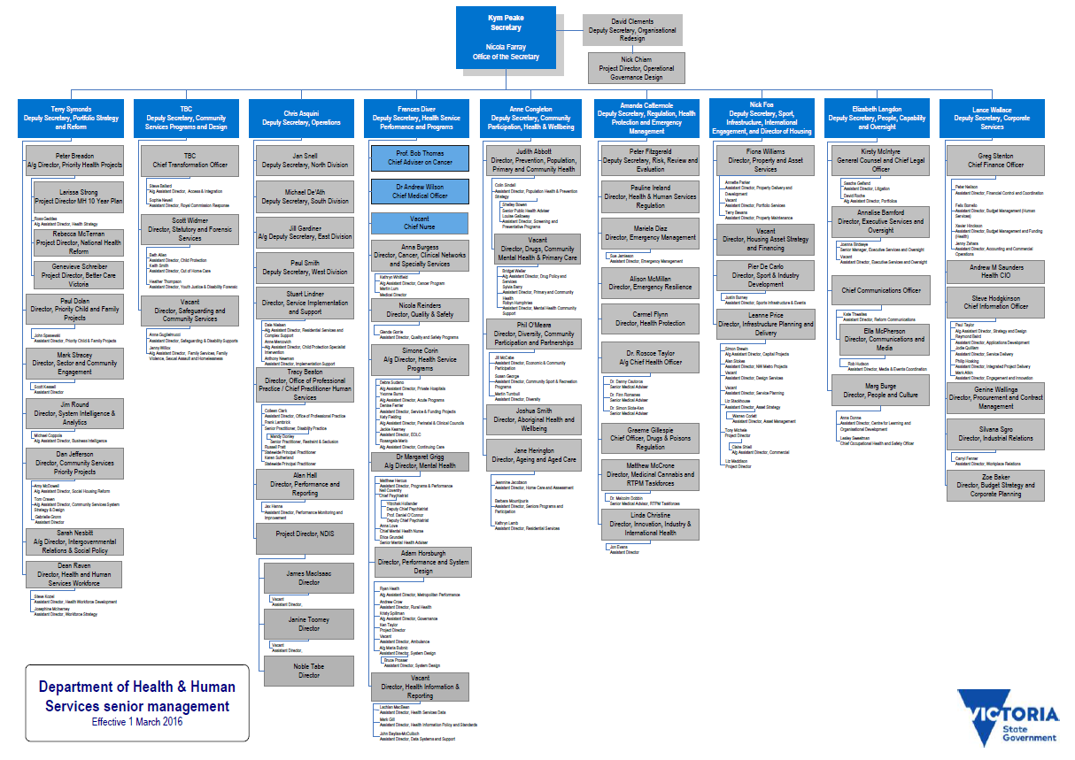
DHHS Organisation Chart 2016

Slide 3
Strengthening Advocacy
Survey results
Survey closed 12 February 2016.
100% response rate
Key themes:
    Many organisations prioritise systemic and self advocacy work.
    There are some gaps in service delivery especially for specific groups including Aboriginal, LGBTIQ
    Organisations vary in terms of the operational systems and processes they have in place.

Slide 4

Strengthening advocacy
Notes:
What are the top advocacy issues for people with a disability?
Top 6 issues:
Housing
Education
Disability Services
Abuse and Neglect
Employment
Access to Supports

Slide 5
Strengthening Advocacy
Feedback to the Office for Disability
Future uncertainty with transition to the NDIS.
Increased demand, case complexity and staff workloads = need for more funding.
Need for better approach to systemic advocacy and mechanisms for sharing information.
Performance targets and reporting inadequate and current requirements are onerous, little feedback on data collected.
Lack of coordination between State and Commonwealth data collection.

